Slide 1
Lending Club Case study

Slide 2
Key Summary
Learning’s
Applicants categorized under Loan B to G have interest rates above 10% to 25% and also have higher proportion of Loans turning into recoveries
  Loans with Grade have interest rate charge of under 5%-10%
  The Mean value denotes the Recoveries tend to be higher in all Loan grades other than Loan Grade”A”
Thus denoting any loan applicantcatgorized under Grade B to E have higher chances of Loan turning out to be charged off and hence end with recoveries
The State wise Loan Grade data denotes applicants from states other than CA, FL NY and TX have predominantly more proportion of Loans that are Grade B to Grade E and higher proportion of them turning into recoveries
Applicants with lesser annual income have higher chances of loan turning into “Charged off” cases and thus ending into recoveries
More than 80% of applicants who have turned into “Recovery have annual income under $10K
More than half of the Interest income earned from the sample turns out be in applicants cases where the Funded amount invested is greater than $20K
  While for the same applicants who’s funded amount invested is $20 K and below have higher recoveries
Applicants with 10+ years of experience have higher share of charged of cases
  people with higher employee experience have higher fund amount invested
  The Median value of Loan amount turning out to be categorized as recoveries are higher in applicants with Employee Work experience 6 years and above
  We can also see that the median value of Loan amount funded is also higher for applicants with Employee work experience greater than 6 years
The Median values of applicants loan turning into recoveries is higher in cases of applicants with Mortgage than the applicant’s who have rented homes
Applicants especially form states like CA,GA,MO,OH and TX have higher chances of turning into Recoveries especially under the category people owning houses under Mortgage
Applicants under the salary range of 30K to 60K have higher proportion of Loans turning into recoveries
The Median value of Applicants Loan amount turning into recoveries increases for those with annual salary greater than $30K and comes down only for those with $300K and above
The Median value of Loans turning into recovery is higher in applicants with Loan purpose as Credit Card, Small Business, Wedding and house
Loans irrespective of any Grades ( A-G) have higher amount of loan turning into recovery under the loan purpose of “Debt consolidation
Loans with purpose of “Vacation and Moving have lower median value of loan amount turning into recoveries
The Median values of applicants loan amount turning into recovery is higher in cases of loans that are “Verified” than those which are not verified
  Indicating the verification process is not that effective in preventing applicants loan turning into default

Slide 3
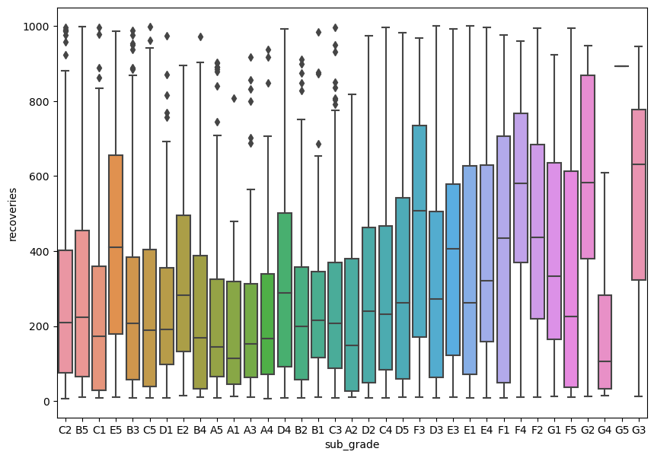
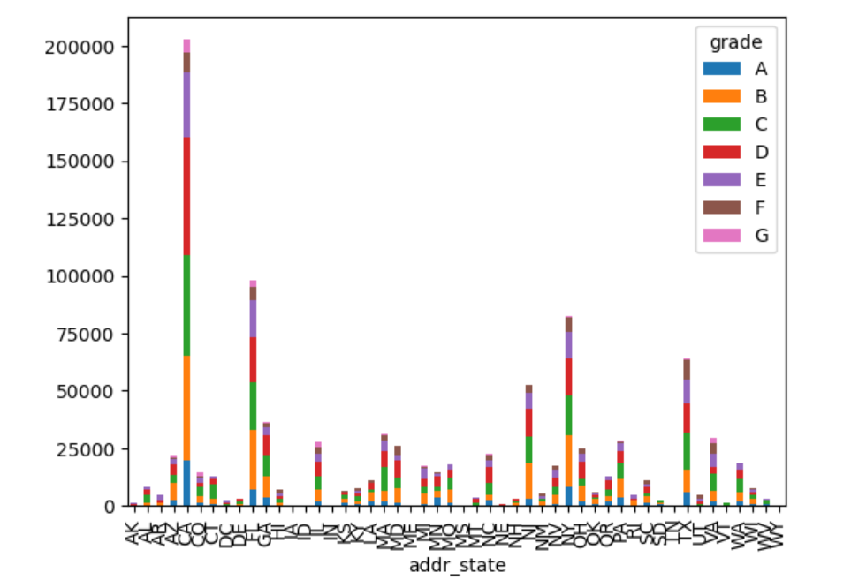
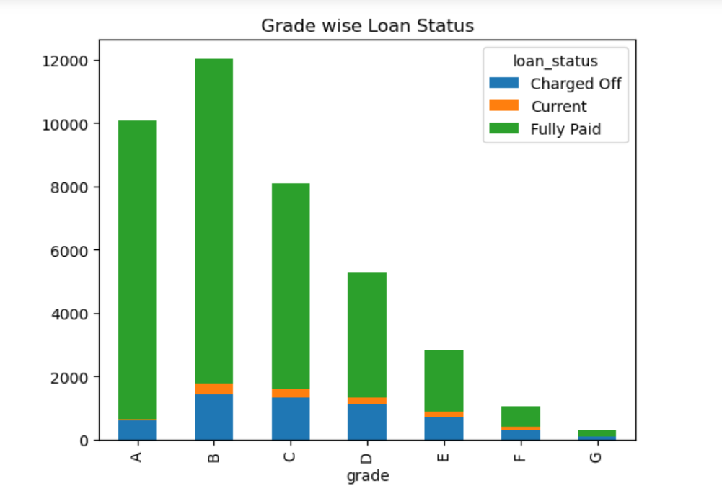
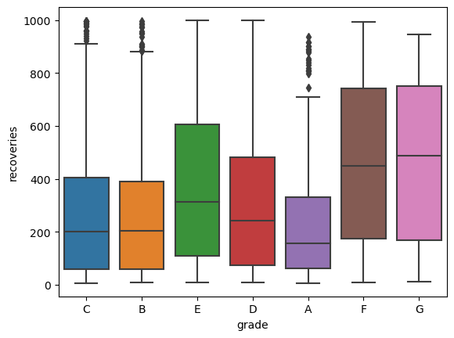
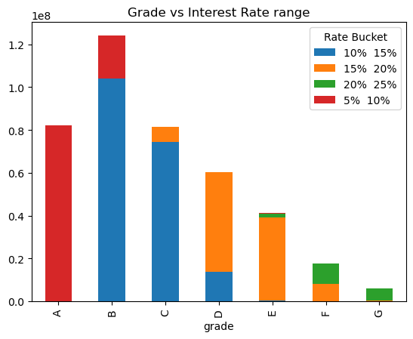
Loan Grade wise Loan Status
Learning’s
Loan Grade type B,C,D, E and F which are collectively 66% and above of the population have higher recoveries than Loan Grade “A”
Loans with Grade have interest rate charge of under 5%-10%
Applicants categorized under Loan B to G have interest rates above 10% to 25% , Thus indicating loans from B-G to have higher proportion of Loans turning into recoveries
The Mean value as can be seen in the box plot denotes the Recoveries tend to be higher in all Loan grades other than Loan Grade”A”
Thus denoting any applicantcatgorized under Grade B to E have higher chances of Loan turning out to be charged off and hence end with recoveries
The State wise Loan Grade data denotes applicants from states other than CA, FL NY and TX have predominantly more proportion of Loans that are Grade B to Grade E

Slide 4
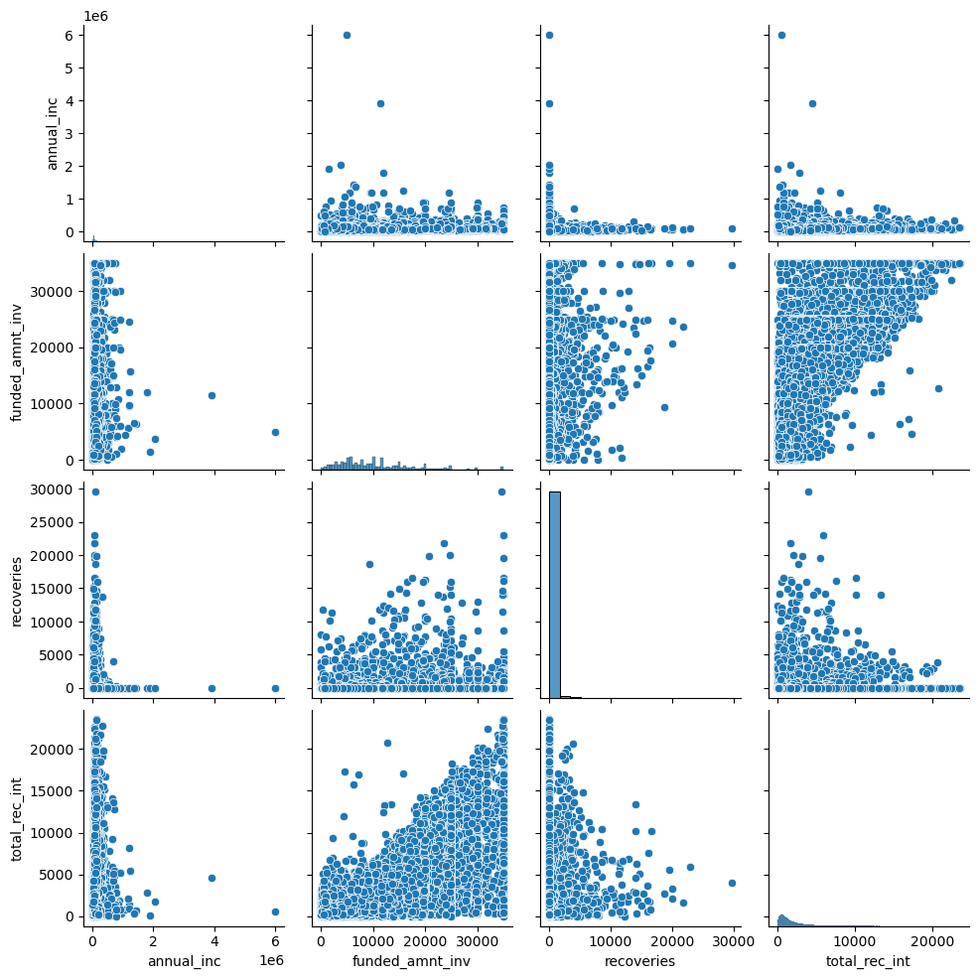
Pair Plot
Learning’s
Applicants with lesser annual income have higer chances of loan turning into “Charged off” cases and thus ending into recoveries
More than 80% of applicants who have turned into “Recovery have annual income under $10K
More than 50% of the Interest income earned turns out be in applicants cases where the Funded amount invested is greater than $20K
While for the same applicants who’s funded amount invested is $20 K and below have higher recoveries

Slide 5
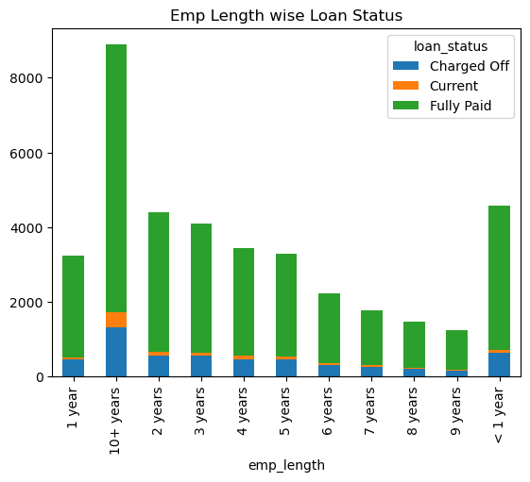
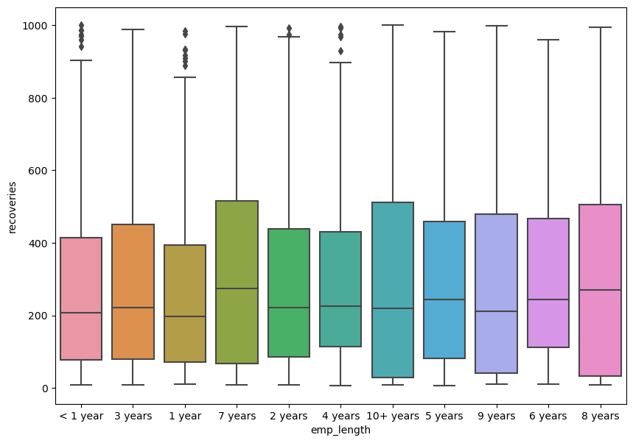
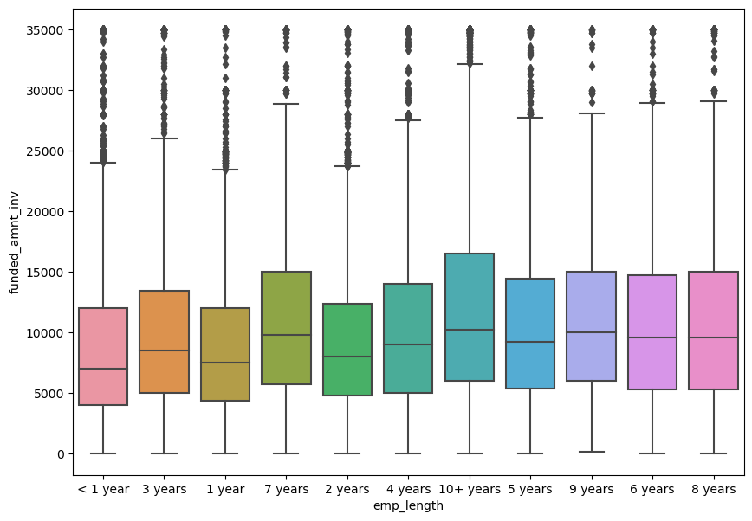
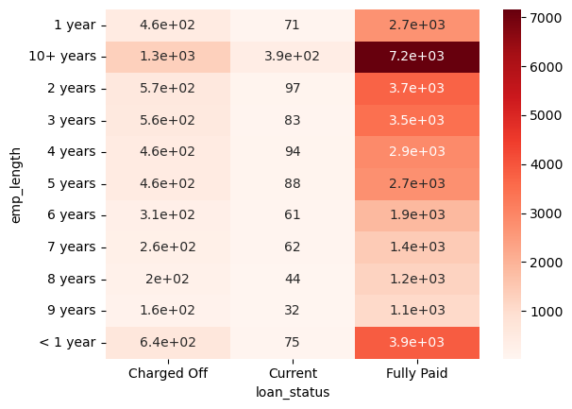
Employee Length of Experience to loan status
Learning’s
Denoting those with 10+ years of experience have higher share of charged of cases among themselves
Denotes people with higher empl exp have higher fund amount invested
Applicants with 10+years of Employee work experience have relatively higher proportion of loans turning out to be charged off
The Median value of Loan amount turning out to be categorized as recoveries are higher in applicants with Employee Work experience 6 years and above
We can also see that the median value of Loan amount funded is also higher for applicants with Employee work experience greater than 6 years

Slide 6
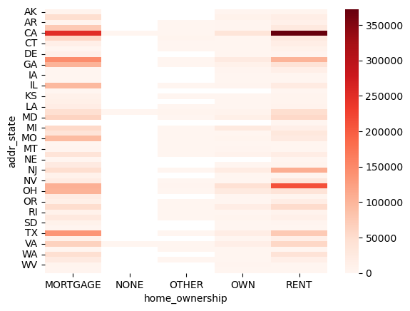
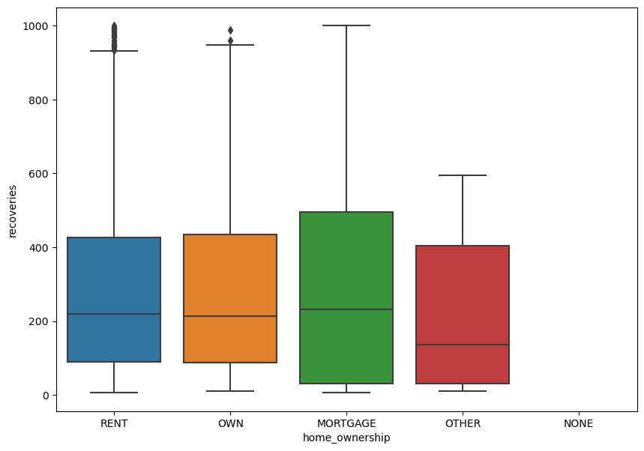
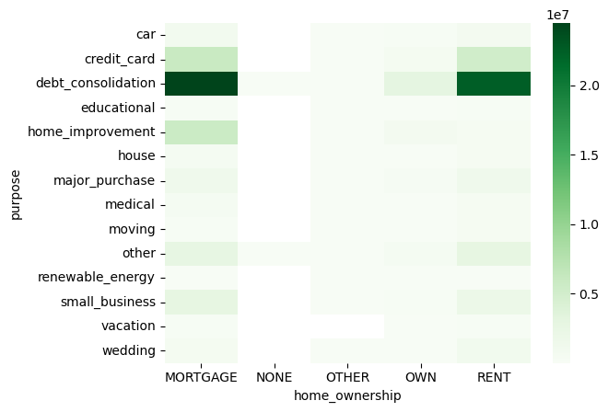
Loan type vs Home ownership
Learning’s
The Median values of applicants loan turning into recoveries is higher in cases of applicants with Mortgage than the applicant’s who have rented homes
Applicants especially form states like CA,GA,MO,OH and TX have higher chances of turning into Recoveries especially under the category people owning houses under Mortgage

Slide 7
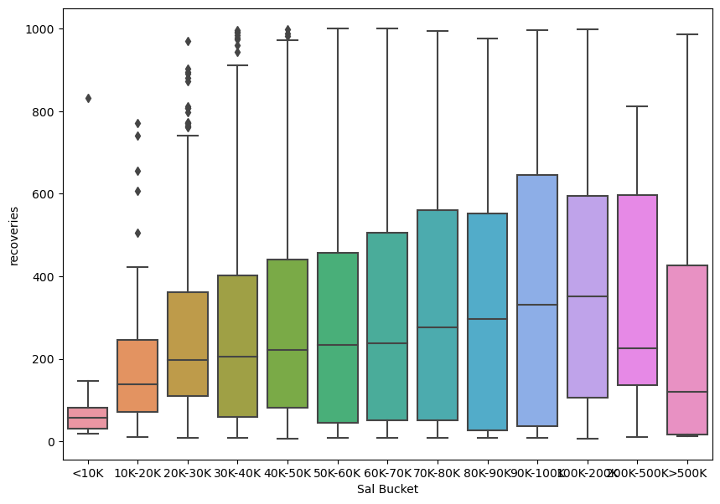
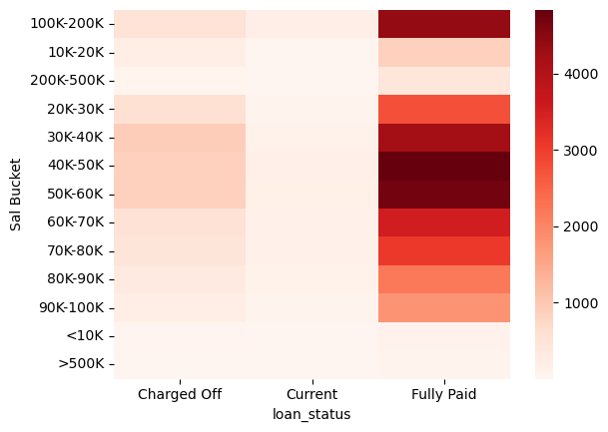
Annual Income wise Recoveries
Learning’s
Applicants under the salary range of 30K to 60K have higher proportion of Loans turning into recoveries
The Median value of Applicants Loan amount turning into recoveries increases for those with annual salary greater than $30K and comes down only for those with $300K and above

Slide 8
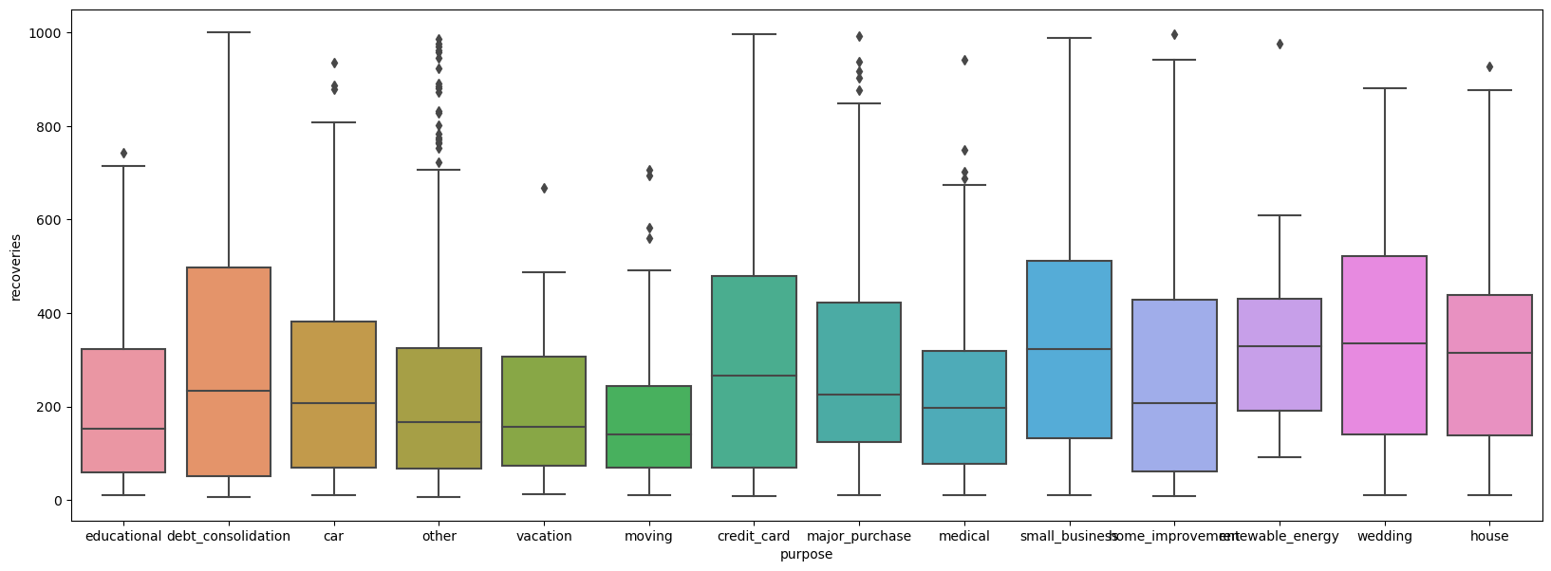
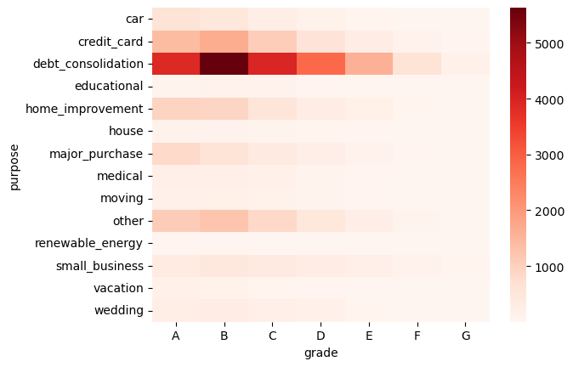
Loan purpose profile
a
Learning’s
The Median value of Loans turning into Debt is higher in applicants with Loan purpose as Credit Card, Small Business, Wedding and house
Loans irrespective of any Grades ( A-G) have higher amount of loan turning into recovery under the loan purpose of “Debt consolidation
Loans with purpose of “Vacation and Moving have lower median value of loan amount turning into recoveries

Slide 9
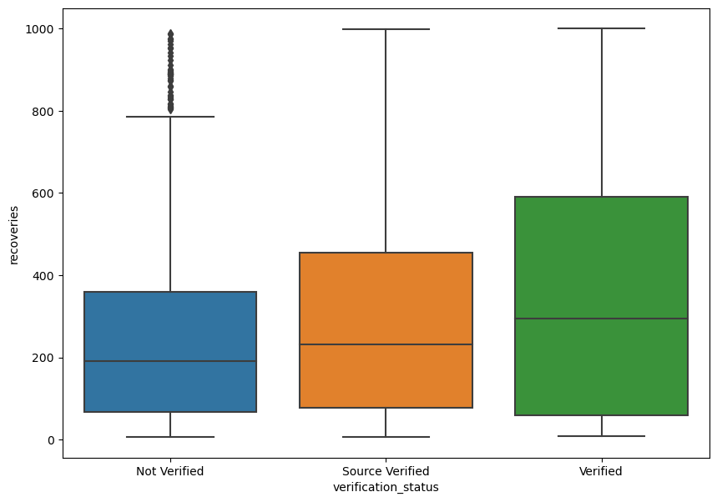
Loan Verified status
Learning’s
The Median values of applicants loan amount turning into recovery is higher in cases of loans that are “Verified” than those which are not verified
  Indicating the verification process is not that effective

Slide 10
Thank You!

